Slide 1



Slide 2


Incoming webhooks hands-on
© 2024 Community Brands Intermediate, LLC. All rights reserved.
Notes:
Presentation:
What are incoming webhooks
NetFourm Incoming webhood processing: diagram
How are they different from REST?
Highlight NetForum REST API
How to setup Incoming Webhooks
Hands-on:
Setting up volunteers sign up form via an external web site
Azure Power Platform: Publish to an external site, permission.
Publish code in GitHub
Allow trainees build the code but they won't be able to deploy

Slide 3

Speaker
Jamal Kahin
Client Services, NetForum Enterprise
© 2024 Community Brands Intermediate, LLC. All rights reserved.

Slide 4
Agenda
Incoming Webhooks
Incoming Webhooks vs NetForum Rest
Incoming Webhook Processing
Setup Incoming Webhooks
Hands-on Lab
© 2024 Community Brands Intermediate, LLC. All rights reserved.

Slide 5
Incoming Webhooks
Allow external system to notify NetFORUM automatically when a particular event happens, for Example Google Forms submission.
Allow external system to send data to NetFORUM then NetFORUM will act on the payload data.
Leverage NetFORUM business layer to orchestrate complex business processes.
© 2024 Community Brands Intermediate, LLC. All rights reserved.

Slide 6
NetFORUM REST (xWeb over JSON)
REST is based on two-way communication (request/response).
Provides different methods to get data out of NetForum
Insert or update any existing objects
Security: Token, HTTPS, Object Security
© 2024 Community Brands Intermediate, LLC. All rights reserved.

Slide 7
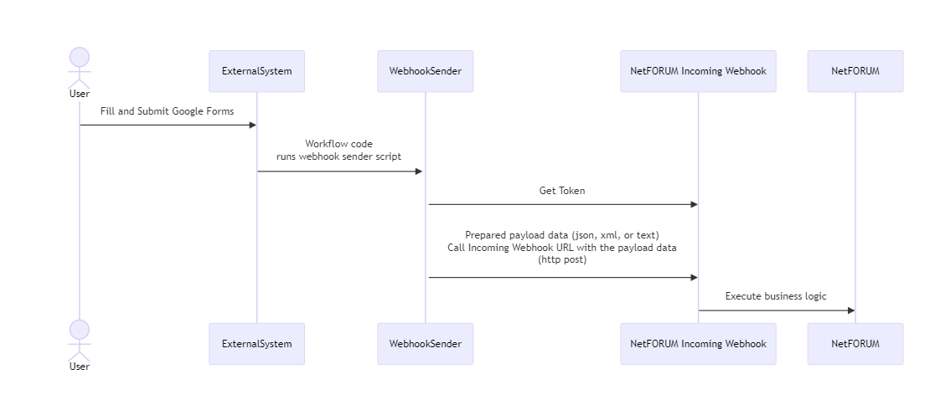
Incoming Webhook Process
Notes:
---
config:
theme: base
themeVariables:
primaryColor: "#11A7F1"
fontSize: 16px
fontFamily: "Trebuchet MS, Verdana, Arial, Sans-Serif"
---
sequenceDiagram
actor User
User ->>ExternalSystem: Fill and Submit Google Forms
ExternalSystem->>+WebhookSender: Workflow code<br/>runs webhook sender script
WebhookSender->>NetFORUM Incoming Webhook: Get Token
WebhookSender->>NetFORUM Incoming Webhook: <br/>Prepared payload data (json, xml, or text) <br/>Call Incoming Webhook URL with the payload data <Br/>(http post)
NetFORUM Incoming Webhook->>NetFORUM: Execute business logic

Slide 8
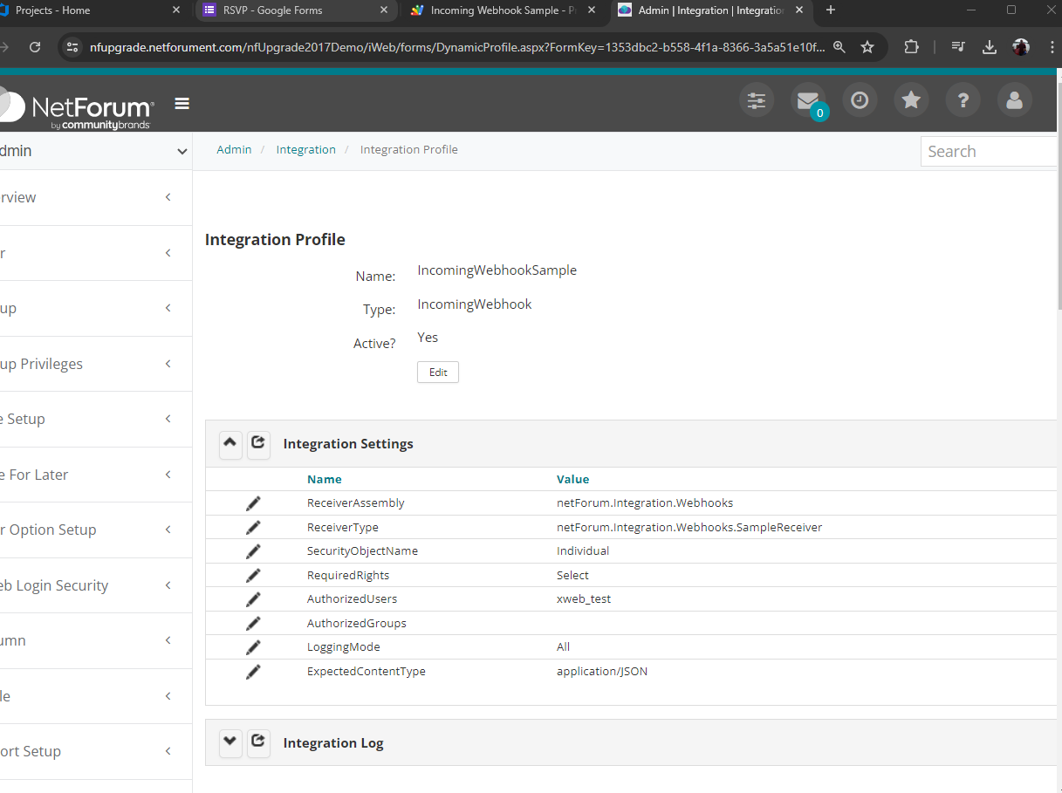
Incoming Webhook Setup – NetFORUM
Create xWeb Account with object security set as required.
Create Incoming Webhook
Use baseline Incoming Webhook Sample as starter, which echo back the posted payload
See configuration image
© 2024 Community Brands Intermediate, LLC. All rights reserved.

Slide 9
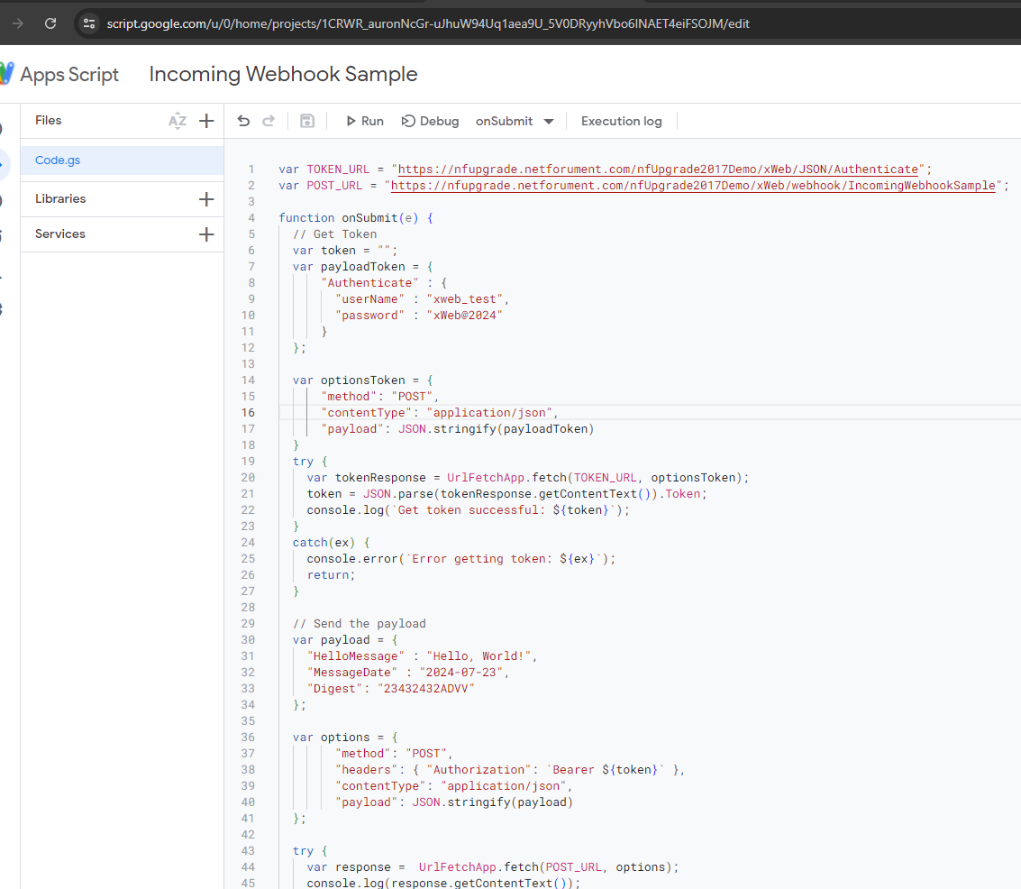
Incoming Webhook Setup – External System
Google Form – Event RSVP
Script Editor Actions:
Webhook URL
Get Token
Prepare Payload
Post to Webhook URL
© 2024 Community Brands Intermediate, LLC. All rights reserved.

Slide 10
Custom Incoming Webhook Setup – NetFORUM
Inherit from WebhookReeiverBase class of netForum.Integration.Webhooks assembly.
Override the ProcessRequest method.
Make sure your Incoming Webhook Integration setup to reflect on your custom assembly and class/method.
© 2024 Community Brands Intermediate, LLC. All rights reserved.

Slide 11
Use Cases
Volunteers sign up.
Contact Request.
Free Event and Session Registration
Simple Survey
© 2024 Community Brands Intermediate, LLC. All rights reserved.

Slide 12
Hands- on Lab
© 2024 Community Brands Intermediate, LLC. All rights reserved.

Slide 13
Ask Us Anything
© 2024 Community Brands Intermediate, LLC. All rights reserved.

Slide 14

Thank you!

